Slide 1
ONLINE FOOD PLAZA
Guided by:
Padmaja Patel
Prepared By-
SHIVNATH DUTTA(1401210324)
VIPUL ANAND(1401210329)
ALOK RANJAN MISHRA (1401210317)

Slide 2
INTRODUCTION
THE SYSTEM DEALS WITH ONLINE ORDERING ,PROCESSING AND DELIVERING FOOD PRODUCT.
ORDERING IS DONE BY VALID CUSTOMER WITH APPROPRIATE ID .
THE ADMINISTRATION RECEIVES ORDER ACKNOWLEDGES THE CUSTOMER ,PROCESS THEM AND ASSURES CORRECT DELIVERY.

Slide 3

CURRENT PROCESS
CURRENTLY IT IS DONE BY ARRIVING TO THE RESTAURANT OR ORDERED THROUGH INTERNET(BY CUSTOMER)
INTIMATION ABOUT THE AVAILABILITY OF ORDERED ITEMS TO THE CUSTOMER (BY ADMINISTRATOR)ONLY.
PROCESSING THE ORDER AND HANDLING IT TO THE RIGHT CUSTOMER.

Slide 4
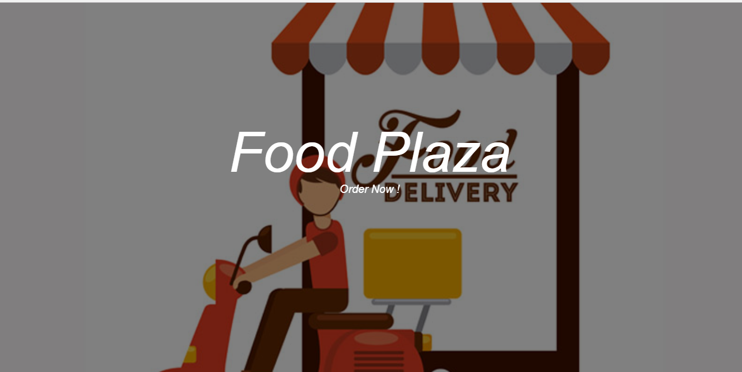
PROPOSED SYSTEM
INSTANTANEOUS ONLINE FOOD ORDER PROCESS SYSTEM(WITH IN 20 MINS).
DEALS WITH REGISTERING OF FOOD PRODUCTS,PRICE LIST AND
AVAILABILITY .ALLOWS FREQUENT UPDATING.
IT ALLOWS VALID CUSTOMER TO BOOK HIS /HER ORDER AND MAKE THEM DELIVERED.

Slide 5
REQUIREMENTS
SOFTWARE REQUIREMENTS:
AN OPERATING SYSTEM (WINDOWS 2000 OR HIGHER).
FRONT-END TO BE DONE THROUGH JS FRAME WORK,HTML AND CSS ,TWITTER BOOTSTRAP.
BACK-END TO BE CARRIED OUT THROUGH PHP.
WEB SERVER XAMPP(APACHE)

Slide 6
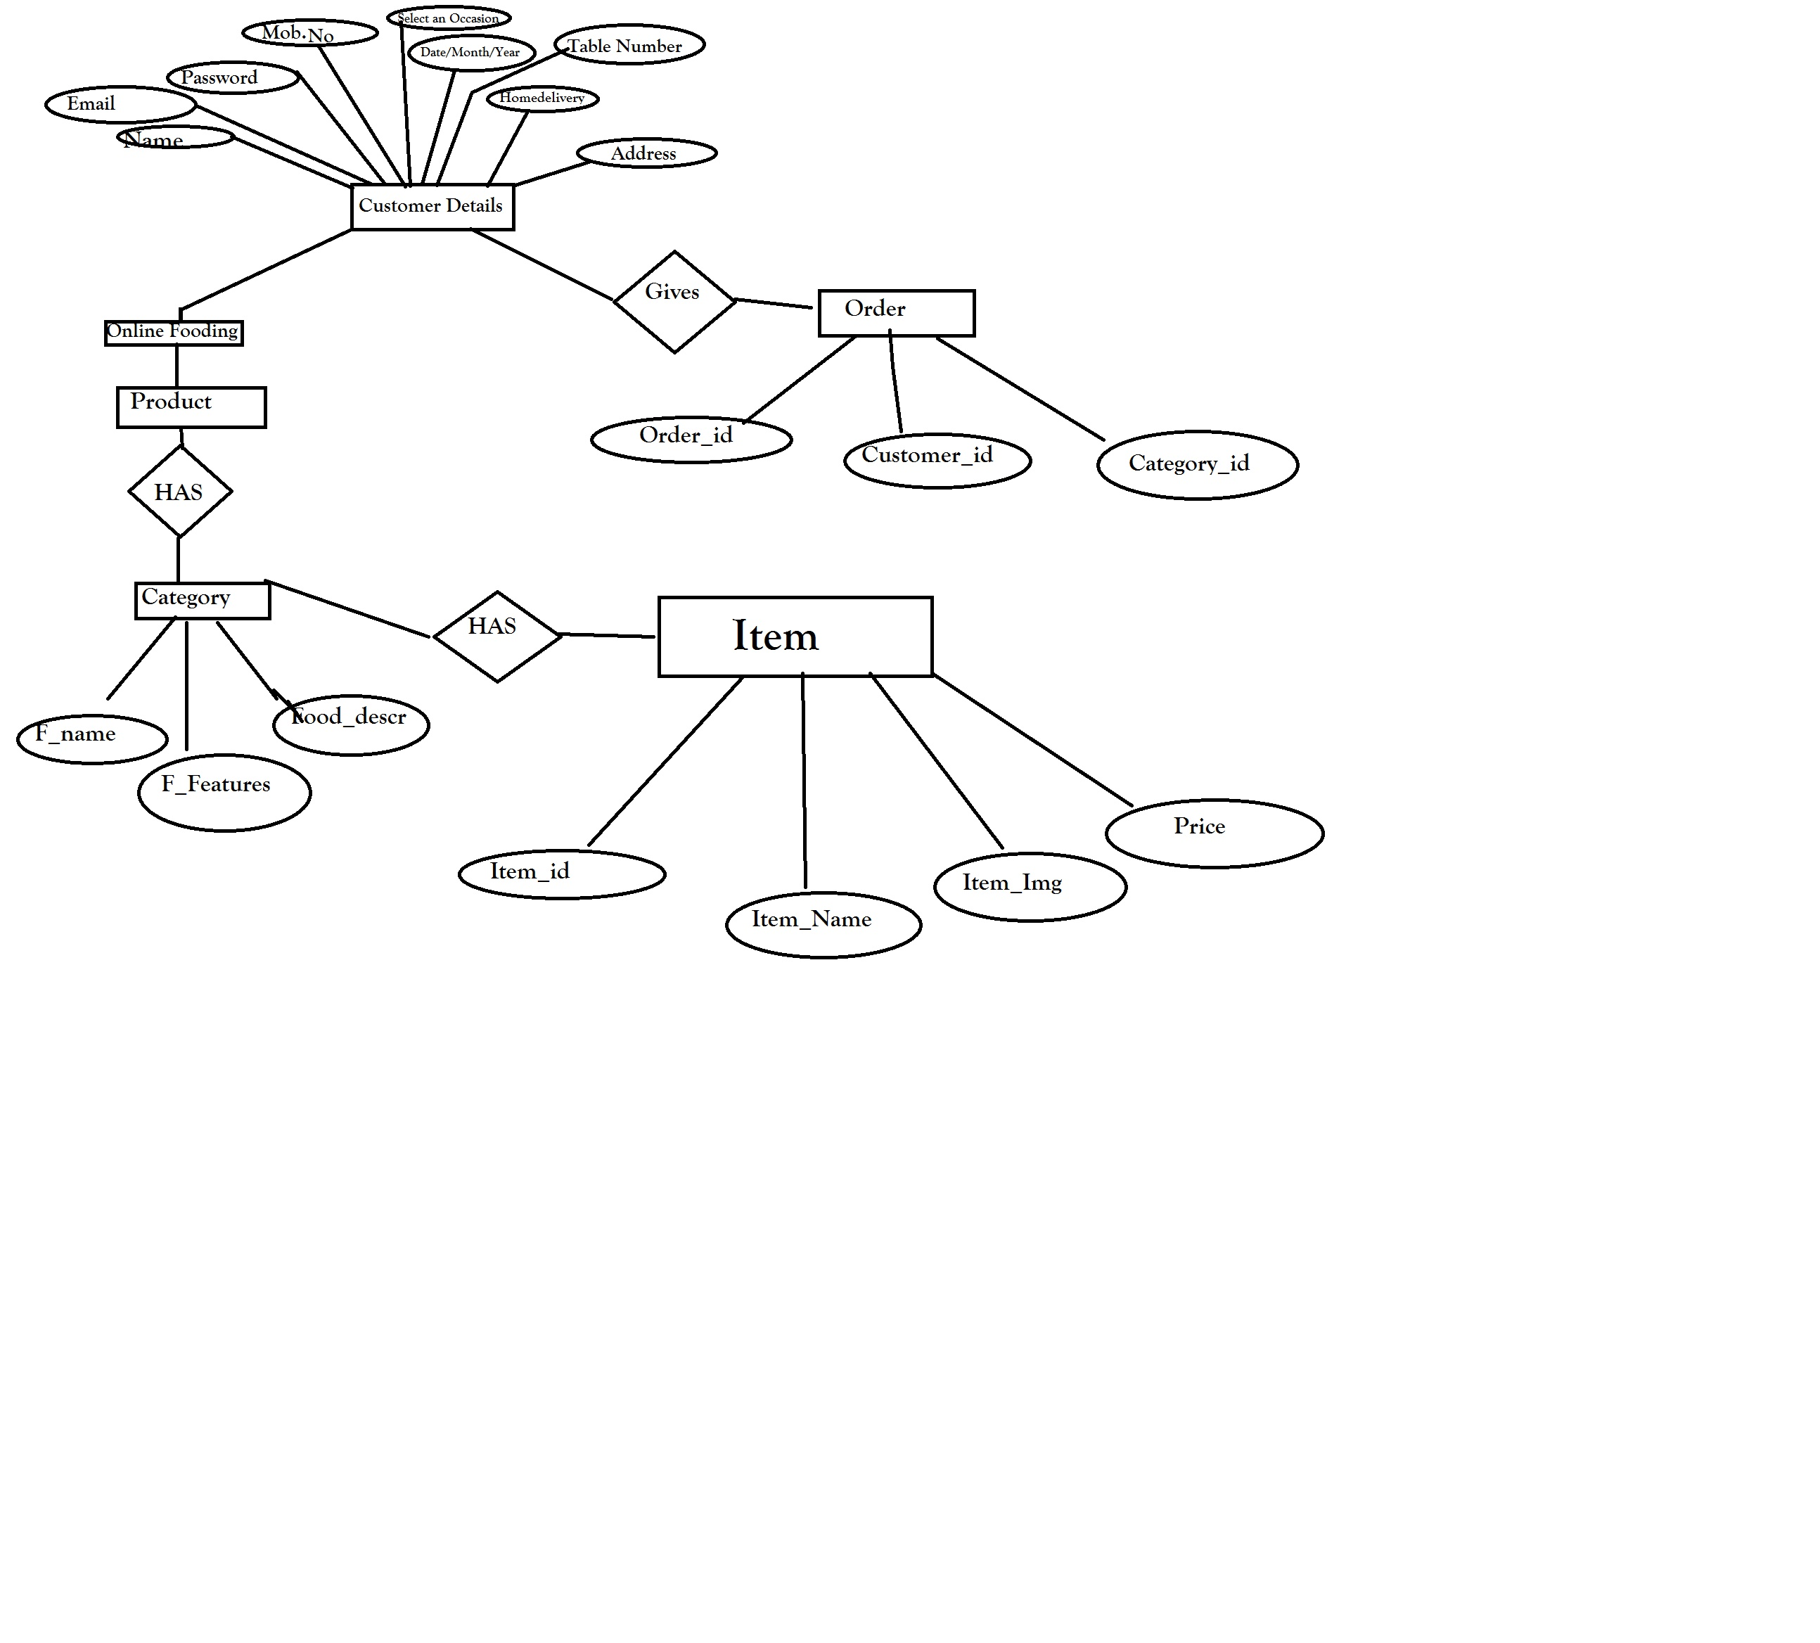
E-R DIAGRAM

Slide 7
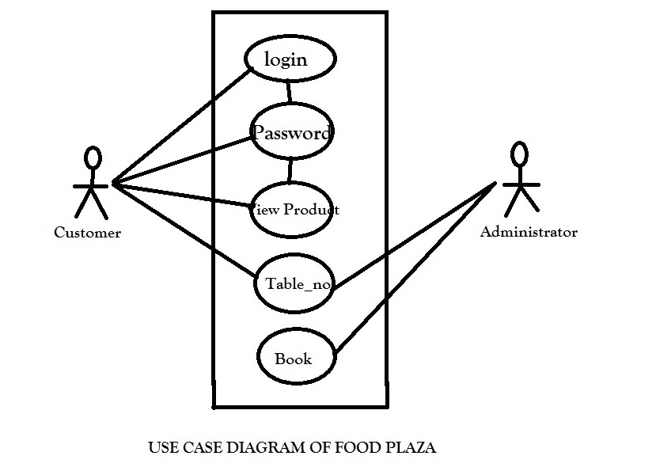

Slide 8
ADVANTAGES
TODAY, MORE PEOPLE THEN EVER ORDER ONLINE THANKS TO THE SMARTPHONES AND TABLETS.
STUDIES SHOWS THAT ABOUT 69% OF CUSTOMERS ORDER FOOD ONLINE USING A MOBILE DEVICE(INTERACTIVE ADVERTISING BUREAU ).
WHETHER STUCK IN TRAFFIC,RIDING THE BUS OR ON A BREAK,ANYONE CAN PLACE AN ORDER QUICKLY AND EASILY,AS OPPOSED TO WAITING UNTILL GETTING HOME OR STARTING TO CALL .

Slide 9
DISADVANTAGES
ITS A TIME CONSUMING PROCESS.
OVERHEAD OF ARRIVING TO THE RESTAURANT OR CONTACTING IT.
UNUSUAL DISTURBANCE THROUGH FAKE ORDERING(THROUGH INTERNET).
REPEATED INTIMATION BY THE ADMINISTRATOR TO DIFFERENT CUSTOMER.

Slide 10
THANK
YOU

